Slide 1
Collaborating on the OfS Statement of Expectations in relation to Disability
Noa Holt, Suzy Allinson
Regulation Manager, Senior Regulation Manager
NUS Southern Union's Conference 2026
20 August 2026

Slide 2
Introduction to the OfS

Slide 3


Higher Education Research and Act (HERA)
HERA outlines our main responsibilities and how we should carry them out.
We also receive guidance from the Department of Education.

Slide 4

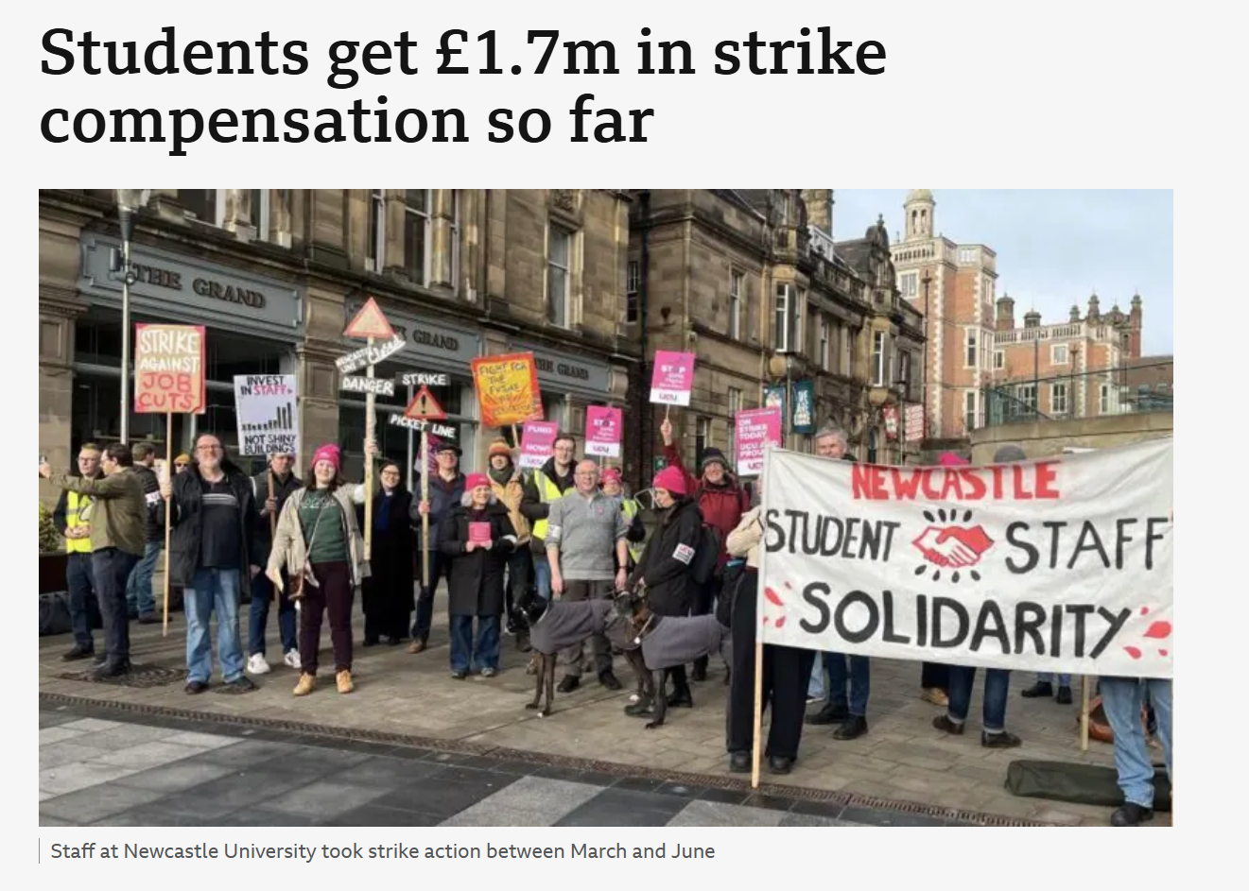




You may recognise some of these areas of work…
National Student Survey (NSS)
Teaching Excellence Framework (TEF)
Fair treatment for students during industrial action
Freedom of Speech
Widening access and participation
Tackling harassment
and sexual misconduct
We’re involved in all these areas!

Slide 5
Did you know?
We regulate over 400 universities, colleges and other higher education institutions in England, ensuring that each of them is meeting their obligations to students.
This includes maintaining high quality teaching and ensuring the rights of students are protected.
Providers must meet minimum requirements, or ‘conditions of registration’, to become registered and also to stay registered with us.

Slide 6

2025-30 Strategic goals

Slide 7
Regulating equality of opportuntiy

Slide 8
How we regulate equality of opportunity
We assess access and participation plans (APPs) – institutional plans for reducing risks to equality of opportunity
We identify sector wide risks to equality of opportunity through the equality of opportunity risk register (EORR)
We provide funding to support sector and provider level activity:
  Uni Connect and Regional Access Partnerships (a collaborative approach to access to higher education)
  TASO (What Works Centre for eliminating inequality in higher education)
  Student premiums and disabled student premium (funding to support successful student outcomes)
  Funding competitions (providing funding to address priority issues, e.g., mental health)
We provide guidance and set requirements and expectations, including the statement of expectations in relation to disability
We monitor compliance and progress through a variety of tools and mechanisms, including through other OfS conditions
We provide data, information and evidence to support understanding and identification of barriers and practice.

Slide 9
The OfS’s role in relation to disability
The OfS aims to ensure that every student, whatever their background, has a fulfilling experience of higher education that enriches their lives and careers.
Distribute funding through the disabled students’ premium and through the premium for student transitions and mental health
APPs
Disability in Higher Education Advisory Panel
Insight gathering and data analysis – student characteristics, outcomes, NSS, student insight, and provider workshops
Strategic communications to highlight issues and positive practice
Statement of expectations in relation to disability.

Slide 10
Development of statement of expectations
Drawing on OfS and other insight and discussions with the Disability in Higher Education Advisory Panel, colleagues in the sector and students
Collaborative approach with the sector
  New phase of Disability in Higher Education Advisory Panel
  Workshops with students and practitioners
  Engagement with mission groups and other key sector stakeholders
  Clarify our expectations as a regulator
  Develop data and insight
  Monitor against the Statement of Expectations – understand sector progress and if individual providers are meeting expectations
  Independent evaluation after several years to understand impact.

Slide 11
Key themes
Legal duties of higher education providers for disabled students
Accountability at a senior level for supporting the needs of disabled students
Staff training on support needs covering different responsibilities for a range of roles
Using data to plan and deliver effective support, including survey results and student outcomes
Working with, and listening to, disabled students and student representatives.

Slide 12
Key themes
Responding to individual needs and taking into consideration multiple forms of disadvantage
Providing accessible information, advice and guidance at key points and communicating clearly
Appropriate and effective information sharing across the institution
Processes for students to raise issues if support isn’t meeting their needs
Evaluating effectiveness of individual support and strategic approaches
Ensuring teaching and assessments are accessible and retain rigour.

Slide 13
Draft key areas of focus
The development, implementation and review of policies and procedures that ensure the inclusion and equitable treatment of disabled students
Clear and accessible provision of information for students
Appropriate staff training to support disabled students
Efficient and sensitive mechanisms for sharing relevant information about disabled students across departments and services
Sufficient capacity, expertise and resources to support disabled students effectively.

Slide 14
Considering the areas of focus…
If you could change one thing that would improve the experience of disabled students in this area what would this be?
What are the barriers to making this happen and how can the statement of expectations address these?
What do you think a minimum expectation should look like in an institution for this theme?
20 minutes

Slide 15
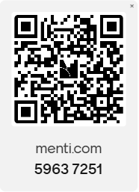
Mentimeter
Please visit menti.com and type in the joining code when prompted, or scan the QR code opposite.

Slide 16
The development, implementation and review of policies and procedures that ensure the inclusion and equitable treatment of disabled students
Clear and accessible provision of information for students
Appropriate staff training to support disabled students
Efficient and sensitive mechanisms for sharing relevant information about disabled students across departments and services
Sufficient capacity, expertise and resources to support disabled students effectively.
If you could change one thing that would improve the experience of disabled students in this area what would this be?
What are the barriers to making this happen and how can the statement of expectations address these?
What do you think a minimum expectation should look like in an institution for this theme?

Slide 18
Insert Image credits as per notes below.
(then delete this message)

